Slide 1

Data
Prepared by: khaled Almir
Supervisor: Dr. Natasha Alkhatib
Position: AI Red team intern at VersifAI

Slide 2
Type of data
Data
Numerical
Categorical

Slide 3
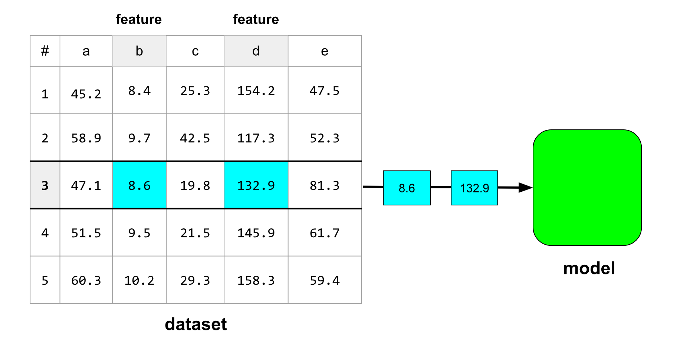
Work with numerical Data

Slide 4
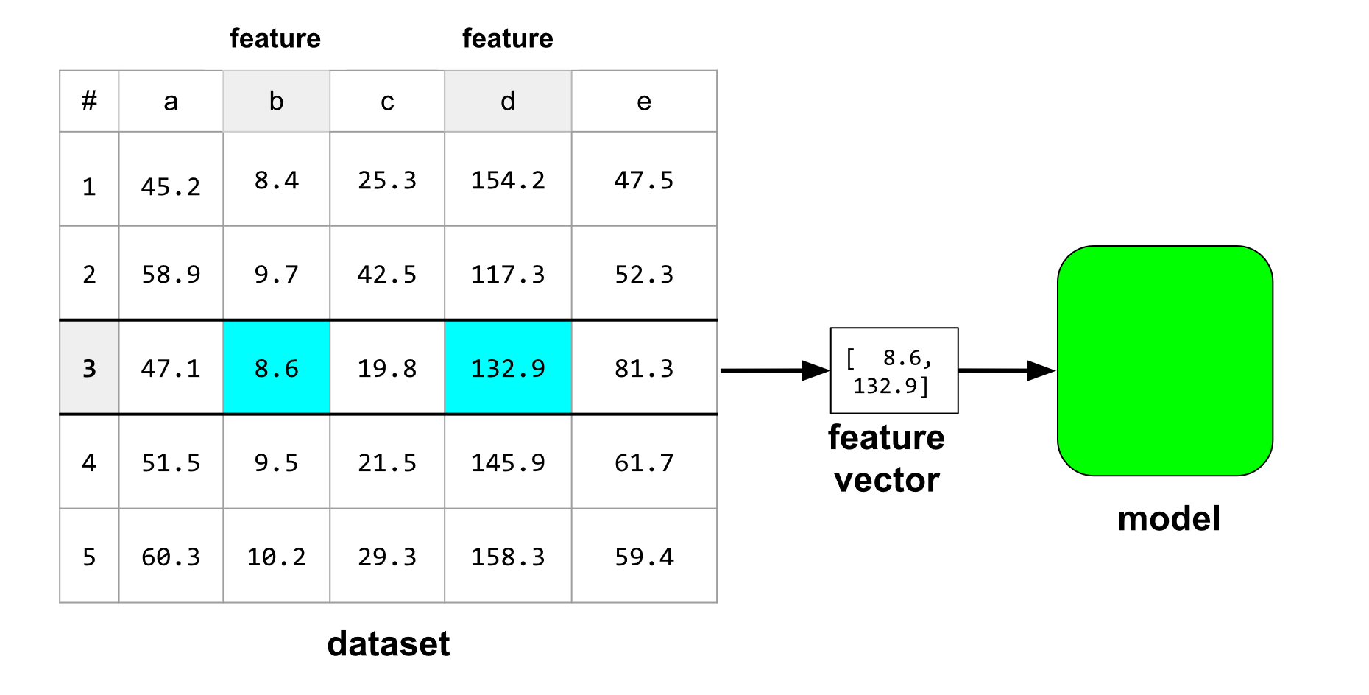
How the model ingest the model

Slide 5
Feature engineering
Crucial step in machine learning.
Feature vector acts as an intermediary between the dataset and the model.
Normalization
Binning (Bucketing)

Slide 6
Recommendation
Visualize the data
Statistically evaluate the data (mean, median and standard deviation)
Find outliers

Slide 7
Normalization
Transform your data in ways that will help your model train more effectively
The goal of normalization is to transform features to be on a similar scale.
Helps models converge more quickly during training.
Helps models infer better predictions
Helps avoid the "NaN trap“ when feature values are very high.
Helps the model _learn appropriate weights_ for each feature

Slide 8
Normalization
Example:
X: 154 → 24,917,482
Y: 5 → 22
After normalization: both scaled to 0–1

Slide 9
Normalization methods
Linear scaling
Z-score Scaling
Log scaling
Clipping

Slide 10
Linear scaling
converts floating-point values from their natural range into a standard range usually 0 to 1 or -1 to +1
x′=(x−x min)/(x max− x min)
where:
x′= scaled value
x = original value
x min = minimum value of the feature
x max= maximum value of the feature

Slide 11
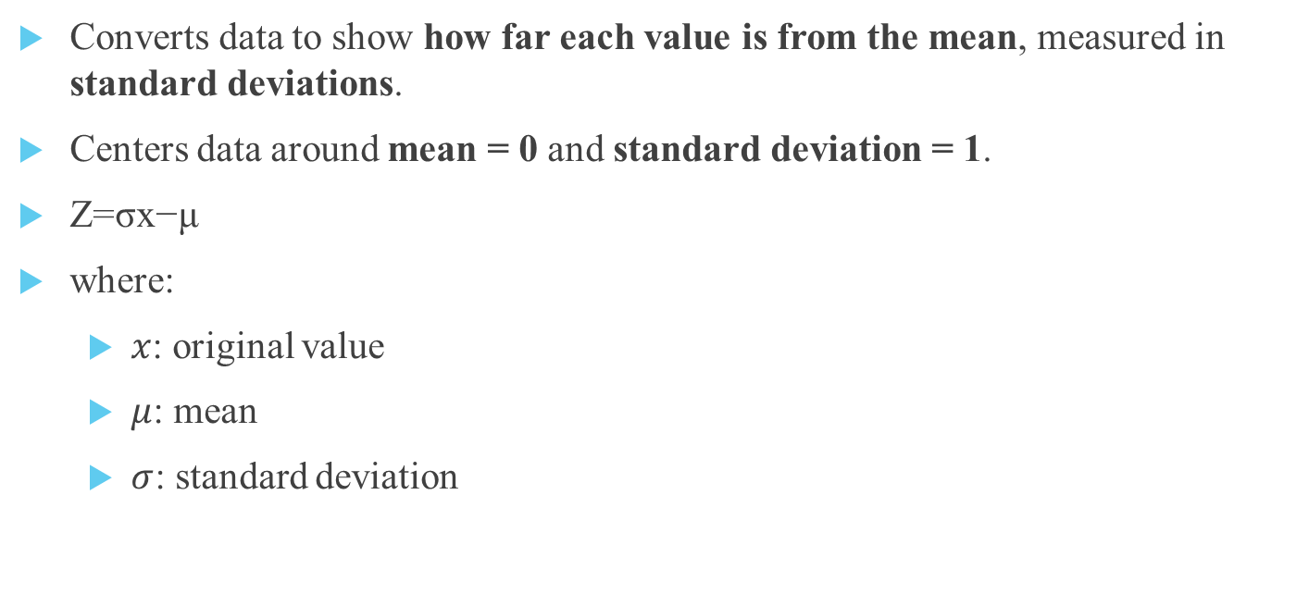
Z-score Scaling
Converts data to show how far each value is from the mean, measured in standard deviations.
Centers data around mean = 0 and standard deviation = 1.
Z=σx−μ​
where:
$x$: original value
$μ$: mean
$σ$: standard deviation

Slide 12
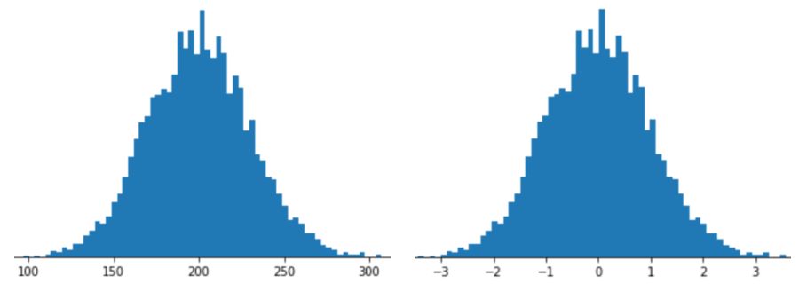
Z-score scaling.

Slide 13
Z-score scaling.
Range | Meaning | % of Data (approx.)
–1 to +1 | Close to the mean | 68%
–2 to +2 | Typical range (normal values) | 95%
–3 to +3 | Almost all data points | 99.7%
–4 or +4 | considered outliers. | very rare

Slide 14
Log Scaling
Works best for power law distributions, where:
Small values are very common.
Large values are rare but extremely high.
Examples:
Movie ratings — few movies get many ratings.
Book sales — few bestsellers sell millions.

Slide 15
Log Scaling
Why It’s Useful:
Raw data with huge value gaps (e.g., 100 vs 1,000,000) is hard for models to learn.
Log scaling compresses these differences, making the data more balanced.
Example:
ln(100) ≈ 4.6
ln(1,000,000) ≈ 13.8

Slide 16
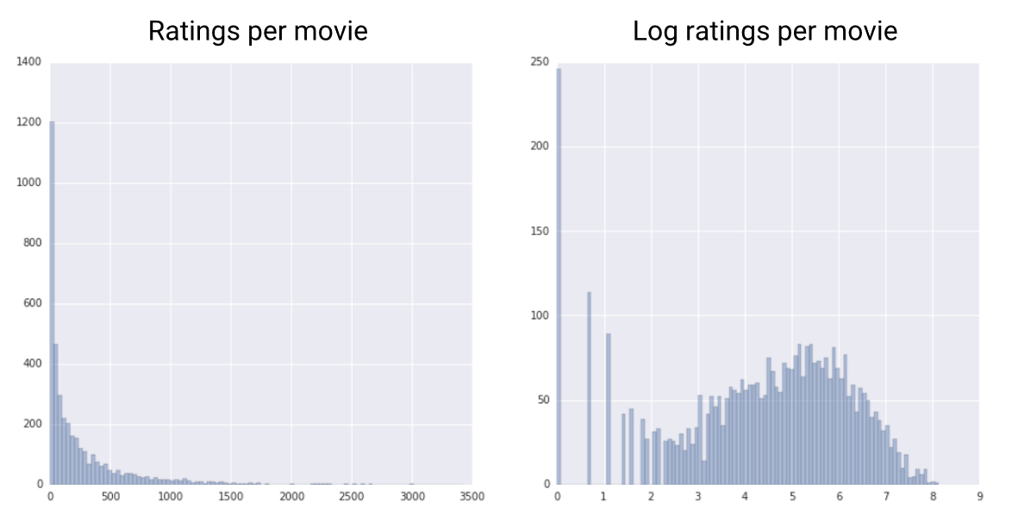
Log Scaling

Slide 17
Clipping
Clipping limits extreme values in a dataset by setting maximum and minimum caps.
Helps reduce the impact of outliers on model training.
Useful:
Prevents outliers from misleading the model
Focuses training on normal, meaningful data
Improves training stability and accuracy

Slide 18
Clipping
Example: roomsPerPerson feature
Most values: 0 → 4
A few outliers: 10 or 17
After clipping:
Values > 4 → 4
Values < 0 → 0

Slide 19
Binning (Bucketing)
Groups numerical ranges into smaller bins or buckets.
Often converts numerical data → categorical data.
Why Use Binning
Simplifies non-linear or complex relationships.
Reduces noise and the effect of outliers.
Highlights clusters in data (when values group together).
Useful when there’s no clear linear correlation with the label.

Slide 20
Binning (Bucketing)
Bin | Range | Feature Vector
1 | 15–34 | [1.0, 0.0, 0.0, 0.0, 0.0]
2 | 35–117 | [0.0, 1.0, 0.0, 0.0, 0.0]
3 | 118–279 | [0.0, 0.0, 1.0, 0.0, 0.0]
4 | 280–392 | [0.0, 0.0, 0.0, 1.0, 0.0]
5 | 393–425 | [0.0, 0.0, 0.0, 0.0, 1.0]

Slide 21
Types of Binning
Type | Description | Best Used When
Equal-Width Binning | Each bin covers the same numeric range. | Data is evenly spread (e.g., temperature ranges).
Quantile (Equal-Frequency) Binning | Each bin contains roughly the same number of examples. | Data is skewed or unevenly distributed.

Slide 22
Scrubbing
Many examples in datasets are unreliable due to one or more of the following problems:
Omitted values
Duplicate examples
Out-of-range feature values.
Bad labels
Can detect by :
Omitted values
Duplicate examples
Out-of-range feature values

Slide 23
Polynomial transforms
A synthetic feature is a new feature created from existing ones — often by raising a numerical feature to a power
This helps capture nonlinear relationships between features and labels while still using a linear model
Why It’s Useful:
Some datasets can’t be separated by a straight line, but can be separated by a curve.
By adding a polynomial term (like x^2), a linear model can draw curved decision boundaries without changing the training method (still uses gradient descent).

Slide 24
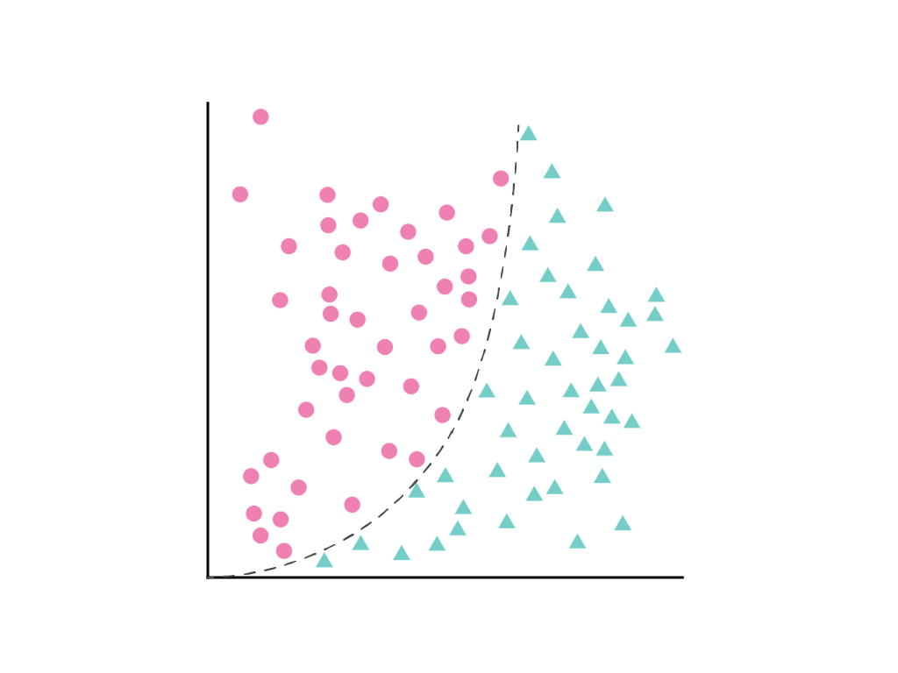
Polynomial transforms

Slide 25
Work with categorical Data
Categorical Data
Has a fixed set of possible values (e.g., animal species, street names, colors, spam or not spam).
Can include numbers that represent categories, not real quantities.
Example: Postal codes — numeric but not mathematically comparable.
Treat such numbers as categorical, not numerical.

Slide 26
Encoding Categorical Data
Machine learning models require numeric input.
Encoding converts categorical/text data into numerical form.
Enables models to learn from values like "dog" or "maple".
Common methods:
One-Hot Encoding – creates a new column for each category.
Label Encoding – assigns a number to each category.

Slide 27
Categorical Feature Dimensions
Dimension = number of elements in a feature vector.
Low-dimensional features have few categories:
snowed_today: True / False
skill_level: Beginner / Practitioner / Expert
season: Winter / Spring / Summer / Autumn
These can use Vocabulary Encoding → each category gets its own feature weight.

Slide 28
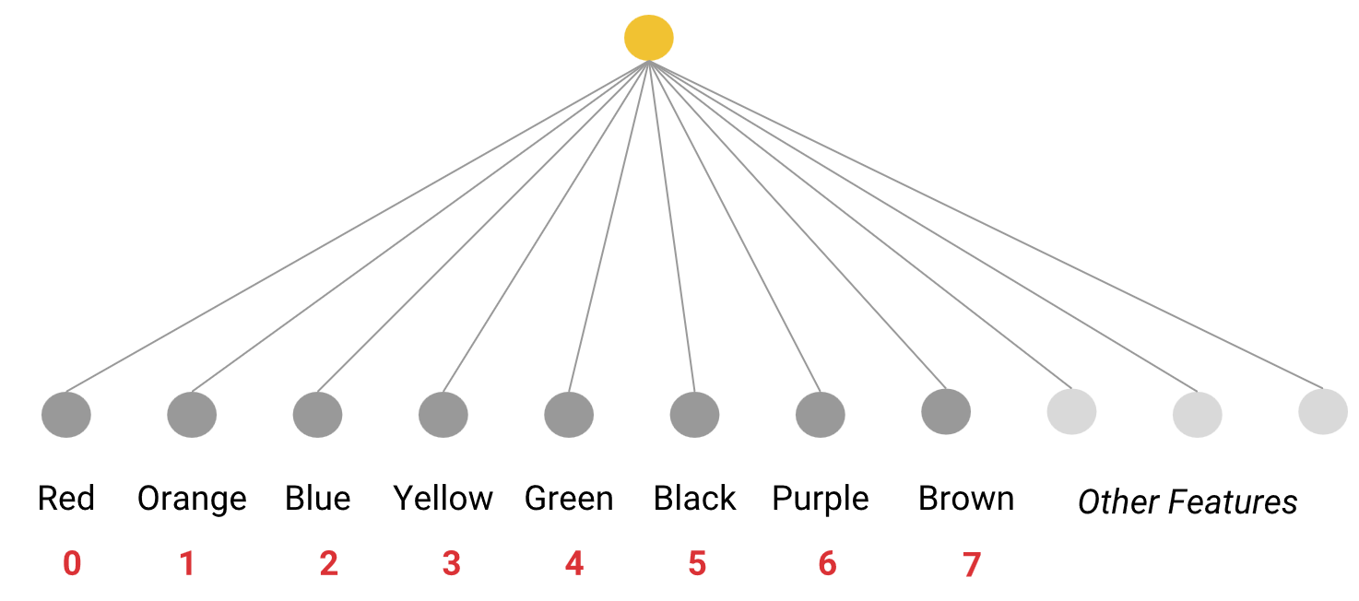
Vocabulary Encoding

Slide 29
One-Hot Encoding
Converts each category’s index number into a vector of 0s and one 1.
Each vector has N elements, where N = number of categories.
Only one element = 1 → represents the active category.
The one-hot vector, not the word or index, is used by the model.
The model learns a unique weight for each category.

Slide 30
One-Hot Encoding
Feature | Red | Orange | Blue | Yellow | Green | Black | Purple | Brown
"Red" | 1 | 0 | 0 | 0 | 0 | 0 | 0 | 0
"Orange" | 0 | 1 | 0 | 0 | 0 | 0 | 0 | 0
"Blue" | 0 | 0 | 1 | 0 | 0 | 0 | 0 | 0
"Yellow" | 0 | 0 | 0 | 1 | 0 | 0 | 0 | 0
"Green" | 0 | 0 | 0 | 0 | 1 | 0 | 0 | 0
"Black" | 0 | 0 | 0 | 0 | 0 | 1 | 0 | 0
"Purple" | 0 | 0 | 0 | 0 | 0 | 0 | 1 | 0
"Brown" | 0 | 0 | 0 | 0 | 0 | 0 | 0 | 1

Slide 31
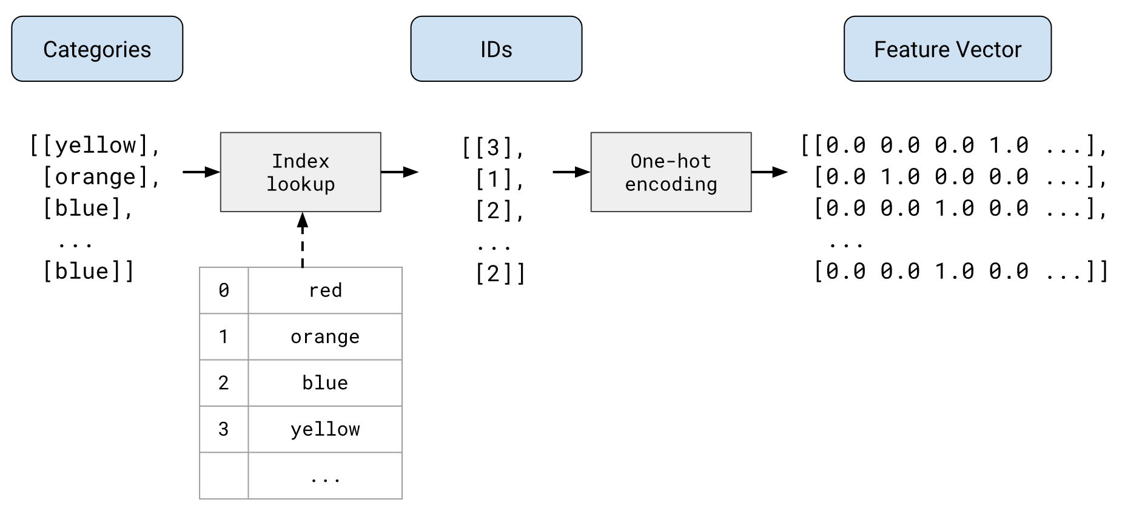
One-Hot Encoding

Slide 32
Sparse representation
It’s just a short way to store that same one-hot vector.
Instead of keeping all zeros and ones, we just save the position of the 1.
[0, 0, 1, 0, 0, 0, 0, 0]` becomes `2` (because the 1 is in position 2).
Used for storage efficiency, not for training.
The model still trains using the full one-hot vector, not the short form.

Slide 33
High-Dimensional Categorical Features
Feature | # of Categories | Examples
Words in English | ≈ 500,000 | “happy”, “walking”
US Postal Codes | ≈ 42,000 | “02114”, “90301”
Last Names (Germany) | ≈ 850,000 | “Schmidt”, “Schneider”
Needs too much memory and slows down training.
One-hot encoding becomes too large and inefficient.

Slide 34
Solutions
Embeddings
Convert categories into low-dimensional numeric vectors.
Reduce size and speed up training/prediction.
Efficient and accurate for large datasets.

Slide 35
Feature Crosses
Combine (cross) two or more categorical or bucketed features.
Help linear models learn nonlinear relationships and feature interactions.
Example
Features:
edges: smooth, toothed, lobed
arrangement: opposite, alternate
Crossed features: {Smooth_Opposite, Smooth_Alternate, Toothed_Opposite, Toothed_Alternate, Lobed_Opposite, Lobed_Alternate}
Example vector for Lobed + Alternate: {0, 0, 0, 0, 0, 1}
Purpose: Identify patterns like species classification.

Slide 36
Feature Crosses vs Polynomial Transforms
Feature Crosses | Polynomial Transforms
Combine categorical features | Combine numerical features
Reveal interactions between categories | Capture nonlinear numeric relationships

Slide 37
Feature Crosses
Use when
When you know certain feature pairs affect the outcome.
If unsure, neural networks can learn interactions automatically (but slower).

Slide 38
Data characteristics
Dataset is a collection of examples.
Types of data
Quantity of data
Quality and Reliability of Data
Complete vs. incomplete examples
Handling Missing Data
Deleting Incomplete Examples
Impute the missing data

Slide 39
Labels
Direct Labels:
Exactly match what the model predicts
Best choice – more accurate and meaningful.
Proxy Labels:
Related but not identical to the target
Used when direct labels are missing or hard to get.
Model accuracy depends on how strongly correlated the proxy is with the true label.

Slide 40
Class-imbalanced datasets
Class-Balanced Dataset
Positive and negative examples are roughly equal
Example: 235 positive / 247 negative
Easier for models to learn both classes equally
Class-Imbalanced Dataset
One class appears far more often than the other
Very common in real-world data
Majority class = common label
Minority class = rare label

Slide 41
Training on Imbalanced Data
Two-Step Technique
Downsample the Majority Class
Train on fewer majority examples
Ensures each batch includes enough minority samples
Example: 99% → downsample by 25 → 80% majority, 20% minority
Upweight the Majority Class
After downsampling, multiply its loss weight (e.g., ×25)
Keeps true class frequency representation
Tuning
Treat downsampling and upweighting factors as hyperparameters
Test different values for the best performance

Slide 42
Dividing the original dataset
Train on one set, test on a different set → proves real performance.
Train on one set, test on a different set → proves real performance.
Split data into 3 parts:
Training set – model learns patterns.
Validation set – tune & test during training.
Test set – final check on unseen data.
Best Practices:
No duplicates between sets.
Keep sets representative & large enough.
Don’t reuse validation/test sets too often → collect fresh data if possible.

Slide 43
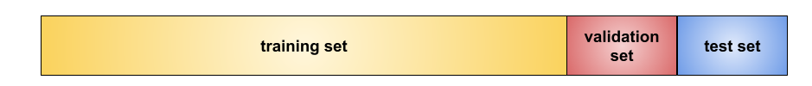
Dividing the original dataset

Slide 44
Overfitting, Underfitting & Generalization
Overfitting: Model memorizes training data → fails on new data.
Like a product that works in the lab but fails in real life.
Underfitting: Model performs poorly even on training data
Not complex enough to learn patterns.
Good Fit: Performs well on both training and new data → generalizes.

Slide 45
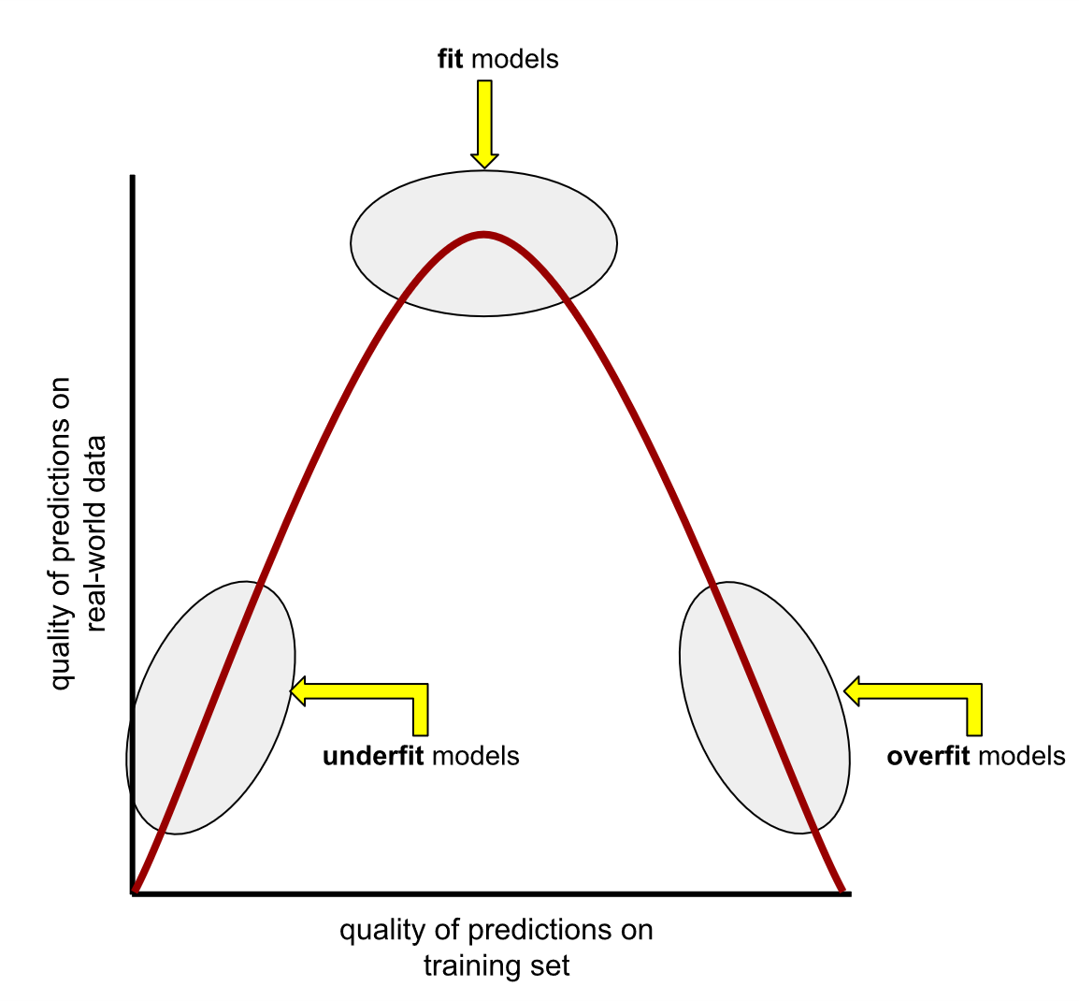
Overfitting, Underfitting & Generalization

Slide 46
Detecting Overfitting
Watch loss / generalization curves:
Training loss ↓ while validation loss ↑ → overfitting.
Both losses similar → good generalization.
Main Causes
Training data not representative of real-world data.
Model is too complex for the dataset size or quality.
To Generalize Well
Independent (examples don’t affect each other).
Stationary (distribution stable over time).
Similar across training, validation, and test sets.

Slide 47
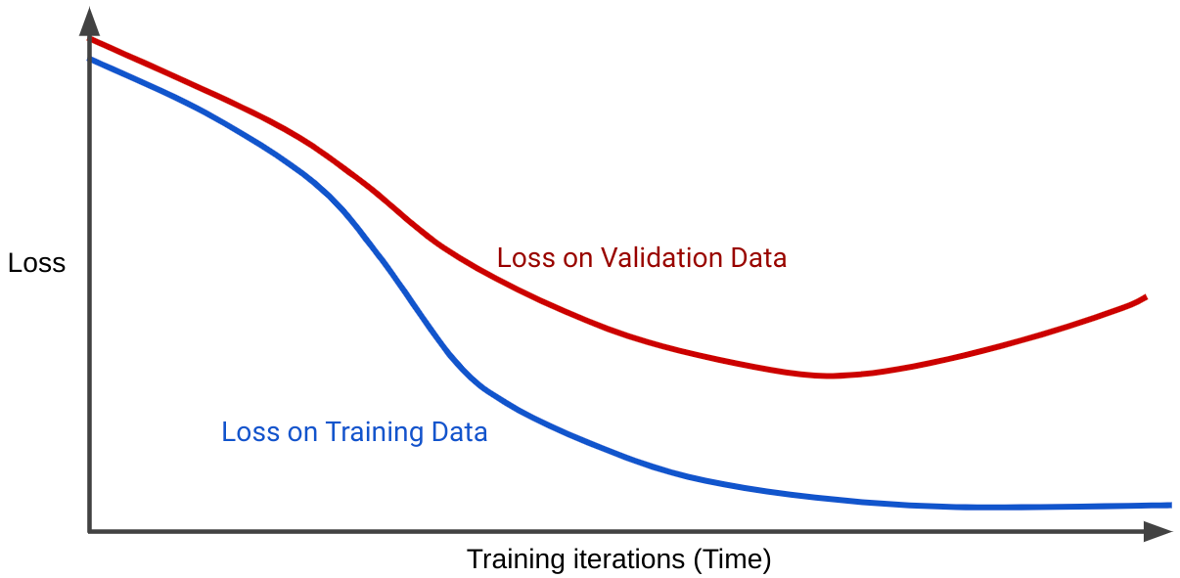
Detecting Overfitting

Slide 48
Model Complexity & Regularization
Complex models → great on training data, poor on new data (overfit).
Simple models → may perform better on test data (generalize).
Regularization
Balances two goals:
Fit data accurately
Keep model simple
Done by penalizing complexity during training → prevents overfitting.

Slide 49
L2 regularization
L2 = w₁² + w₂² + … + wₙ²
Penalizes large weights → encourages simpler models
Example: One large weight (e.g., w₃ = 5.0) can dominate total complexity → L2 encourages weights toward 0, but never exactly 0

Slide 50
Regularization Rate (λ)
Training minimizes: loss + (λ × complexity)
Large λ:
Strong penalty → smaller weights
Less overfitting
Weight histogram: narrow, centered near 0
Small λ:
Weak penalty → more flexibility
Higher risk of overfitting
Histogram: wider spread
λ = 0: No regularization → highest overfitting

Slide 51
Thanks for your attention!!

